Slide 1


Slide 2
House Rules
Collaborative Learning
If you DON’T know, ask (you can also, google ☺)
If you’re NOT SURE, validate
If you DO know, share (your unique experience)
Feel free to correct me, or add on the topic
Say your name, say your name

Slide 3
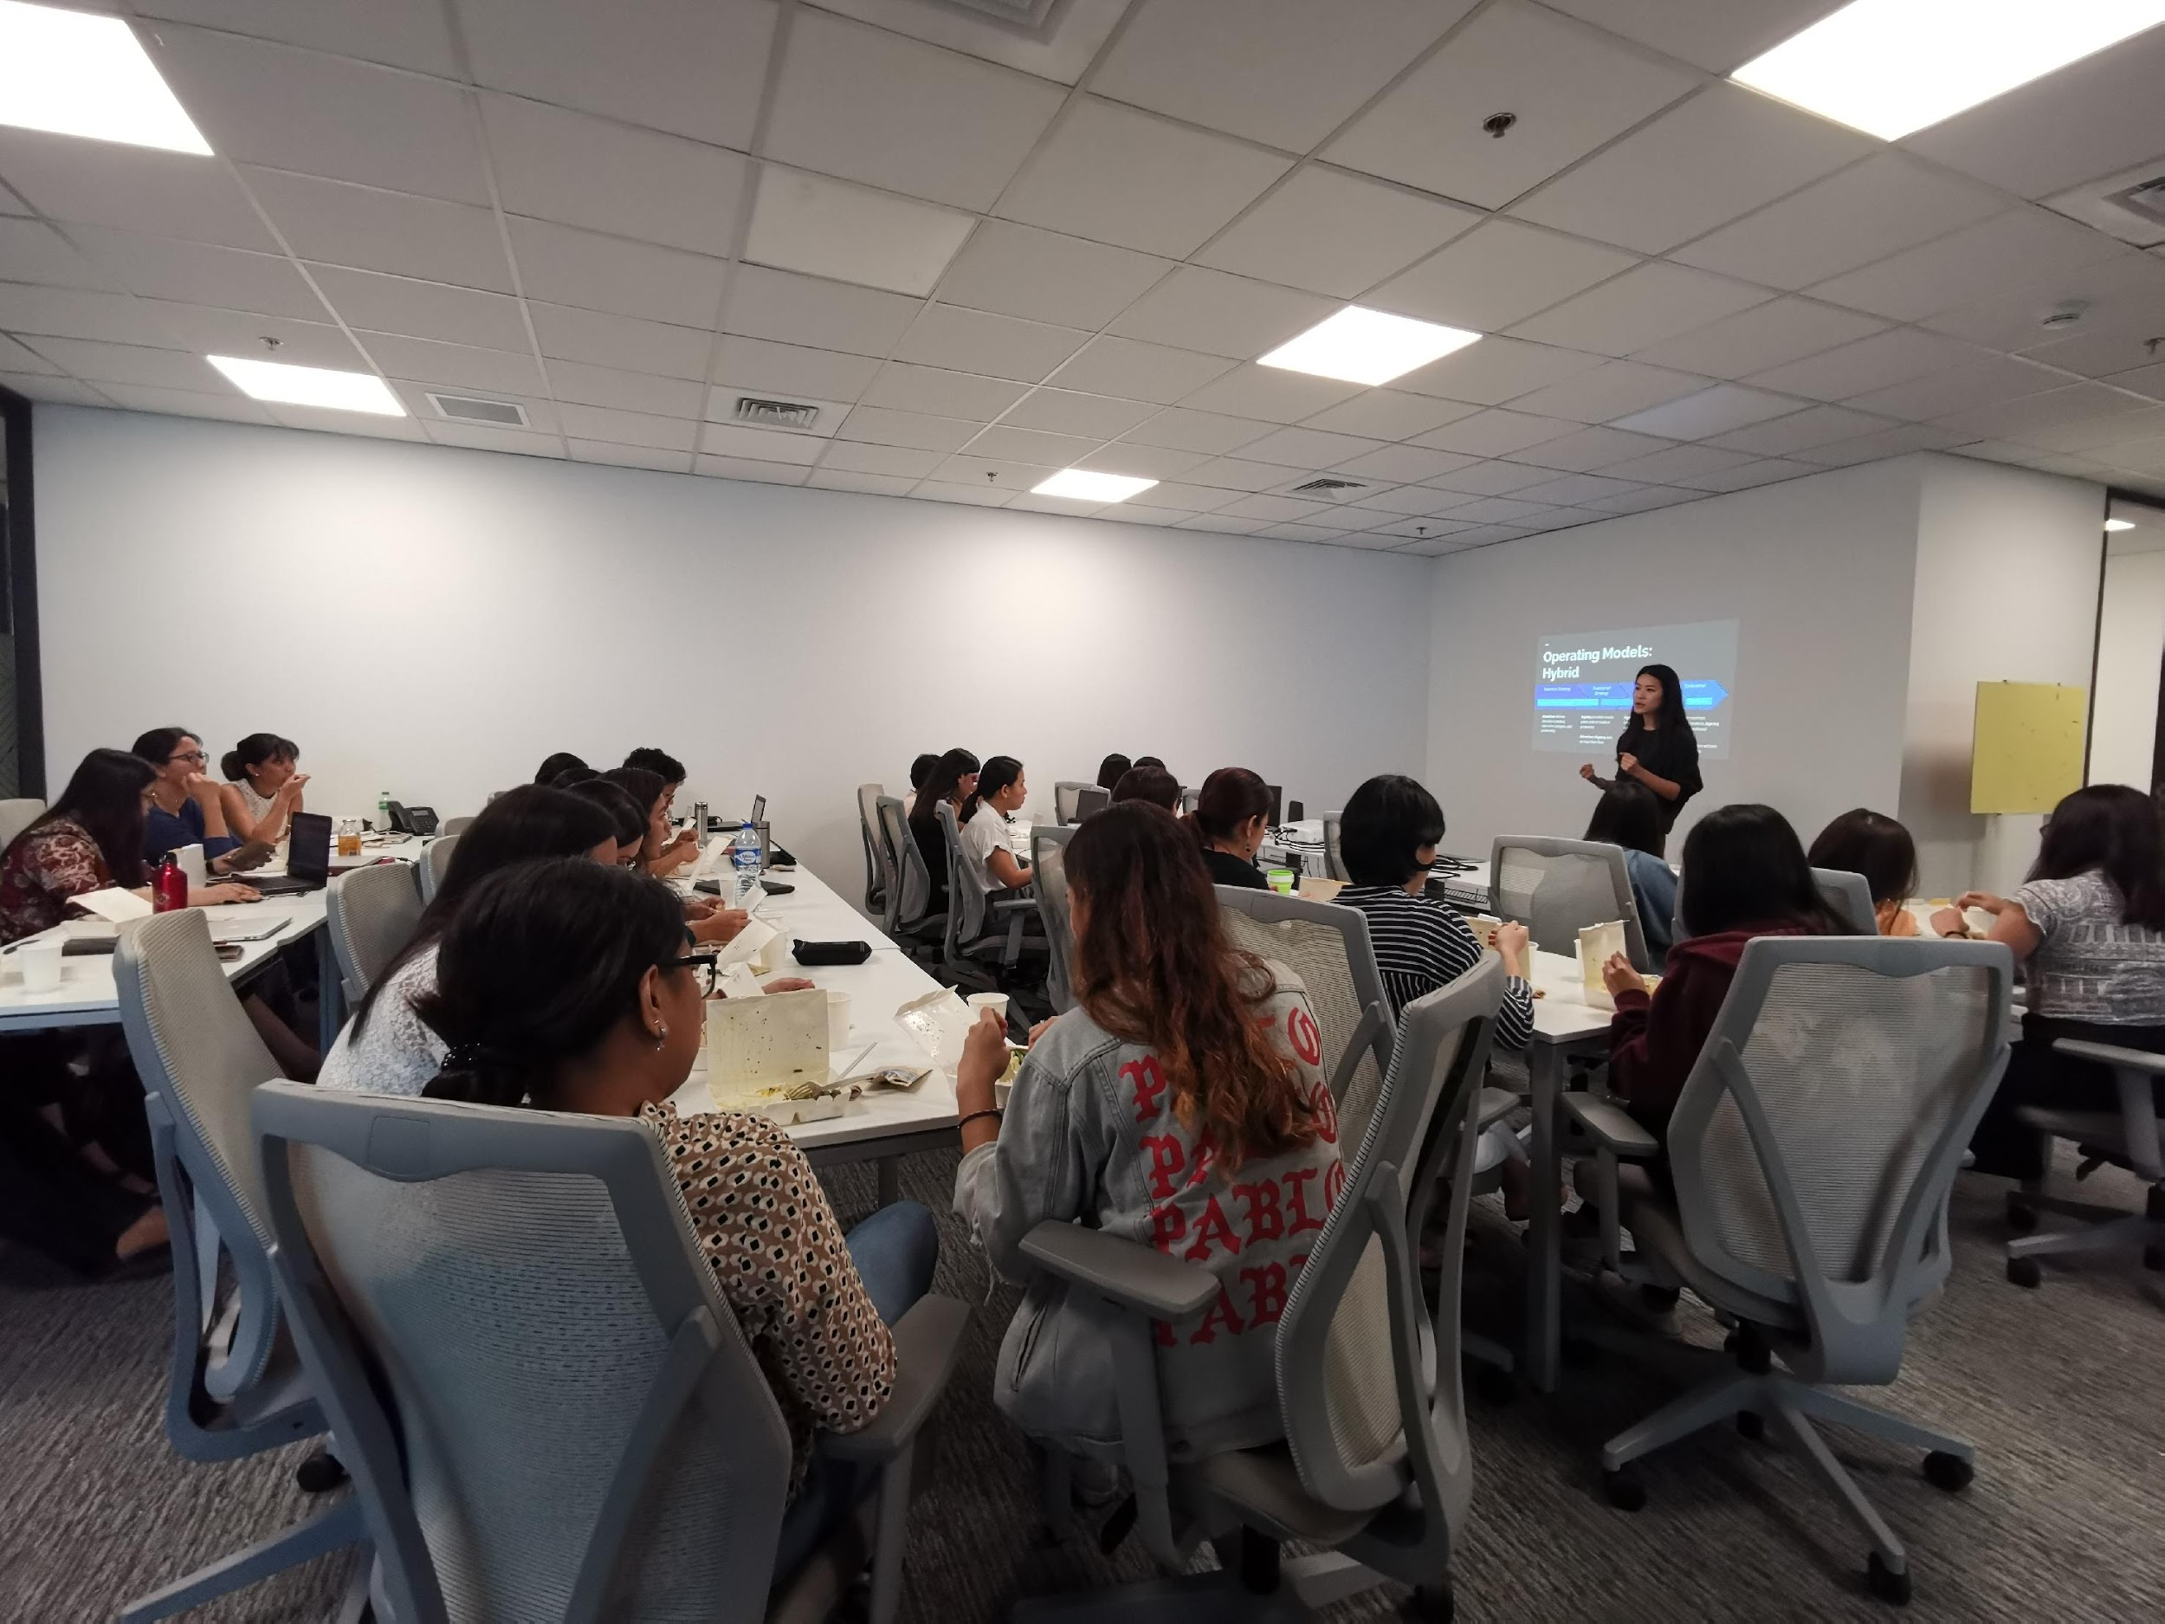
Forbes 2016
Data scientists spend 60% of their time on cleaning and organizing data. Collecting data sets comes second at 19% of their time, meaning data scientists spend around 80% of their time on preparing and managing data for analysis.

Slide 4
Data Management

Slide 5
Data Management
Key Topics
What is Data?
What is Data Management?
Upstream vs Downstream Journey
Data Scientists vs Data Management

Slide 6
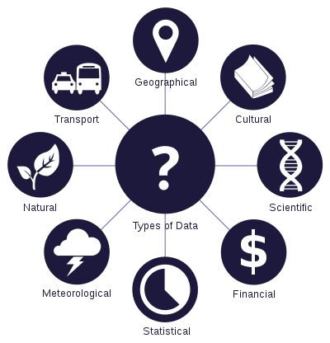
Data Management
What is Data?
Originally, data is plural for “datum”, a Latin word
Datums are most often called “data points”
Data represents a collection of data points (also called datasets)
Can be used as both singular and plural form
Data are characteristics or information, usually numerical, that are collected through observation.
- Wikipedia

Slide 7
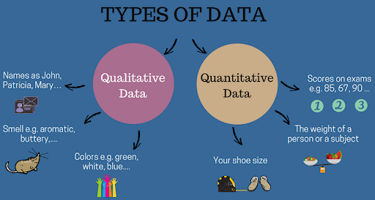
Data Management
Types of Data
Quantitative – Numbers, tests, counting, measuring ( still confused? Ask -- can it be counted?)
Qualitative – Words, images, observations, sounds, videos, conversations, etc.

Slide 8

Data Management
Data or Metadata?
Metadata is DATA that DESCRIBES another DATA
Example:
FTW is FUN!
Data without metadata can potentially be worthless ☹

Slide 9
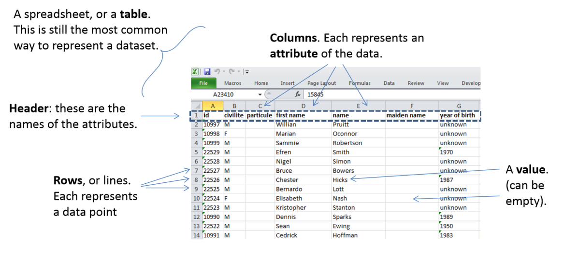
Data Management
Example: People Data stored in Excel tables

Slide 10
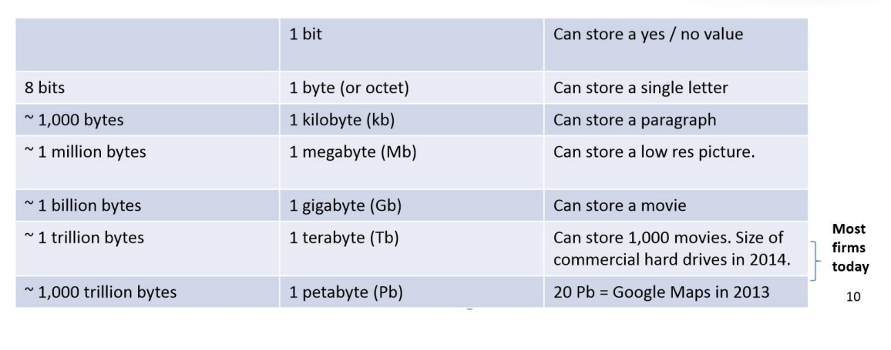
Data Management
Understanding Sizes
The size can give an idea of amount of data that can be processed as well as potential challenges it might give
Dataset size is expressed in data points ie. Lines, rows and/ or columns depending on the structure of the data you are analyzing
Size can also be expressed in terms of storage consumption

Slide 11
Data Management
Data vs Information vs Knowledge
Data
Raw facts
No context
just numbers, text, images, videos, etc.
Information
Data with context
Processed data
Value added to data
Summarized
Organized
Analyzed
Graphed / Visualized
Described
Knowledge
How is this information tied to outcomes?
Are there any patterns in the information?
What information is relevant to the problem?
How does this information affect the system?
What is the best way to use the information?
How can we add more value to the information?

Slide 12
Data Management
The Data Lifecycle
Generation / Collection
Data is “born” and need to be collected and stored
Use
Processed data / information / knowledge is accessed by end user applications
Cleansing / Preparation
Once gathered, data needs to be “prepared” for use
Analysis / Processing
Data is transformed for use towards specific business problems
Sharing
Data is shared to users for reporting, analysis, or further collection

Slide 13
What is Data Management?

Slide 14

Data Management comprises all disciplines related to managing data as a valuable resource.
Close your eyes and imagine this young fragile plant is our DATA.
What do we need to do to manage and take care of it?
- Plantita / Plantito data scientists, probably

Slide 15
BUZZY WORD
“DATA IS THE NEW OIL”

Slide 16
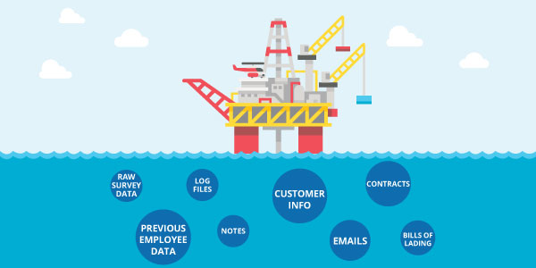
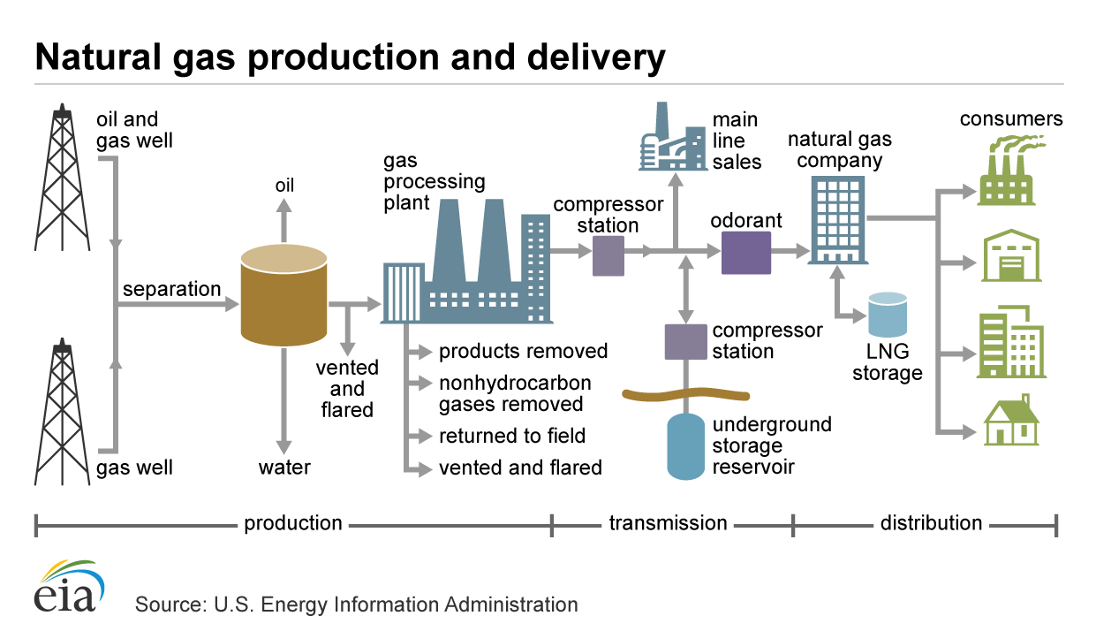
Data Management
Data Management Journey
Upstream
Downstream
Find the data
Collect the data
Clean the data
Store the data
Process the data
Serve data
Analyze the data
Govern the data

Slide 17
Upstream Journey

Slide 18
Upstream – Find the Data
First ask the question, what data do we need / “might have” and does it actually exist?
People
Products
Location
Activities

Slide 19
Upstream – Collect the Data
If the data exists, where is it generated / captured so we can collect them?
Traditional
Observations
Tests
Surveys
Documents
Corporate
Point of Sale
Inventory Systems
HR systems
Internet Proxy
How are they collected?
Analog VS Digital
Offline VS Offline
One time VS Batch VS Realtime
Edge Sensors
Weather balloons
ID scanners
CCTV cameras
Home internet routers
BONUS: External Data
Government Websites
Yellow Pages
Twitter
Data sellers ie. Nielsen

Slide 20
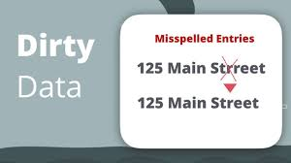
Upstream – Clean the Data
How do we know if our data is dirty?
How do we make a plan to clean it?
Duplicate Data
Outdated Data
Insecure Data
Incomplete Data
Inaccurate / Incorrect Data (source vs rule)
Inconsistent Data
Excessive Data*
Manual Data 🡪 Digital Data
Fix in storage VS Fix at source

Slide 21
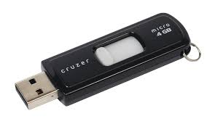
Upstream – Store the Data
Where and how do we store our data?
Location
Local
On prem Server
Cloud
Format
Flat Files ie. CSV, Excel
Binary
Database
Retention
How long do we keep the data?
How much do we keep?
How recent do we refresh it?
Security
Who can access the data?
Is the data encrypted?
Is there a backup strategy?

Slide 22
Downstream Journey

Slide 23
Upstream – Process the Data
Once we have it – What do we need to “change/transform” the data to make it usable?
Add
Enrichment via Joining of other data
Derivation of calculated values
Business rules
Change
Translation ie. 1 to Female
Remapping of variables
Splitting of variables
Aggregation
Removal/ Filtering
Dropping of invalid data
Deletion of unneeded columns
Removal of duplicates

Slide 24
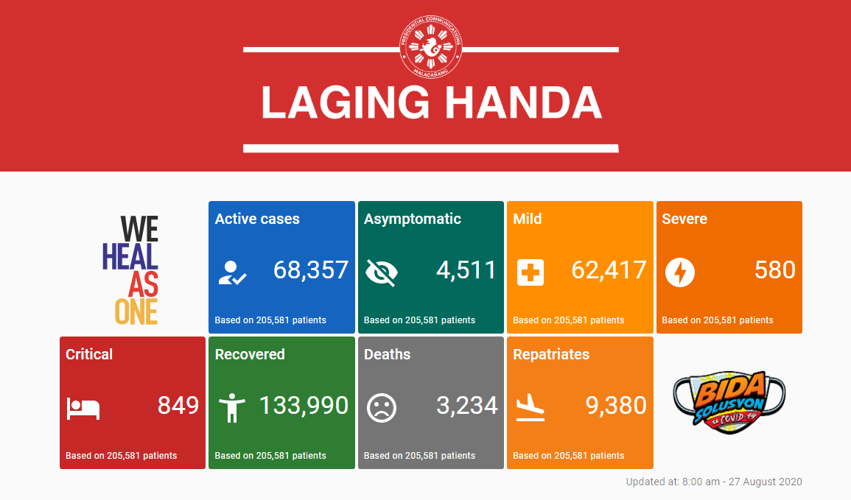
Upstream – Serve the Data
How do we share the data so people can use it?
Centralized Internal Database
Secure API over Internet
Restricted network drives
Password protected files
Business Intelligence / Reporting
Dashboards
Archiving
Legal

Slide 25
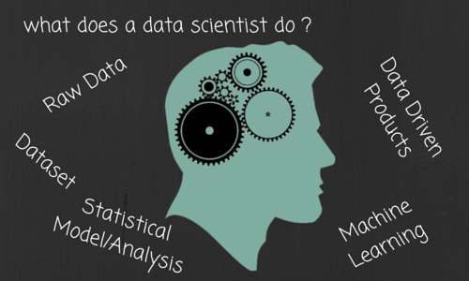
Upstream – Analyze the Data
Can the data do more?
This is where YOU come in!
What tools can we use on the data? Ie. R, Python, SAS, Java, Tableau, PowerBI, etc.
What new insights / knowledge can we generate / explore out of the data?
Can these new insights / knowledge be used to create new value or address existing business problems?

Slide 26

Upstream – Govern the Data
Taking care of our data
Data Quality
Data Model & Architecture
Metadata / Data Dictionary
Ownership, Access and Security
Retention and Backup

Slide 27
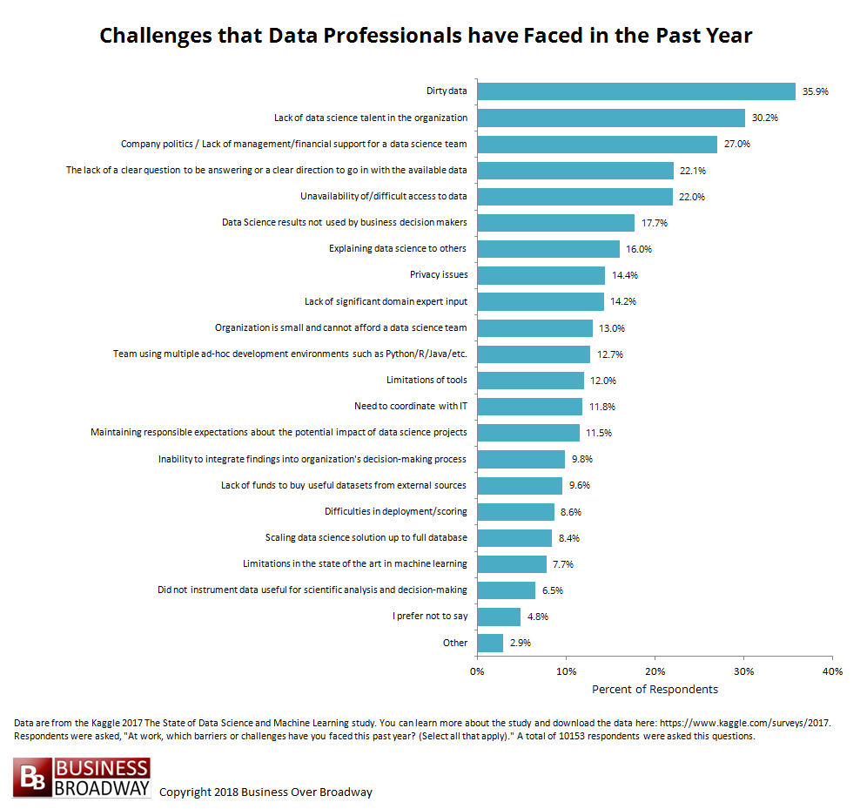
Data Scientist vs Data Management

Slide 28
Data Scientist vs Data Management

Slide 29
Data Management
Group Activity (30 mins)
Analytics Problem: <insert your problem statements here>
What dataset/ points do you think can help your use case? (internal? external?) clue: match against your key questions
Where do you think these data points can be found? ie. sources, systems
What are potential problems/ challenges to these data? ie. cleanliness, data privacy, formatting, does not exist
What treatments do you think should be done to the data to make it more usable ie. transformation/ aggregation
In other words, answer this question: What do you need, data wise, to be able to start working on your analytics project?
Each group to present their results (5-10 mins)

Slide 30
Python IO
https://github.com/ogbinar/python101/blob/master/notebooks/10_file_io.ipynb
https://github.com/ogbinar/python101/blob/master/notebooks/14_advanced_io.ipynb

Slide 31
Thank You!

Slide 32

So you now have DATA, so what?
NEXT WEEK: Exploring your data

